Slide 1




Server 709
HACKTOBERFEST 1.0
Group -24
Group -24

Slide 2






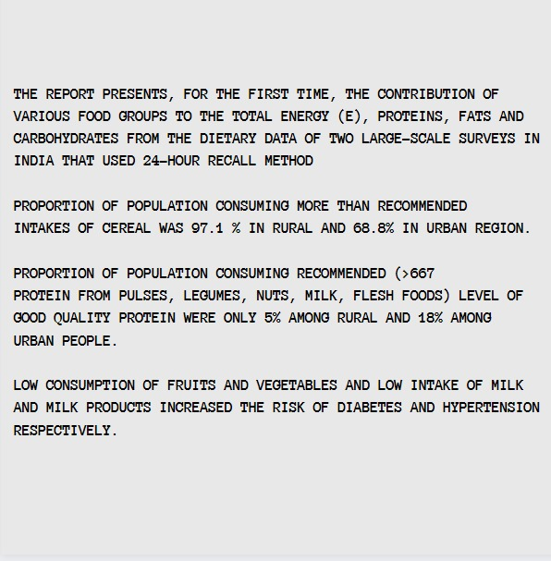

FF
CALOHERO
CALORIE TRACKER. PS-04
Develop a cutting-edge web application to address the pressing need for effective calorie monitoring intake and diet personalized recommendations. A robust calorie tracking system to simplify daily intake monitoring, the capability to generate customized diet plans tailored to individual goals and preferences, and the ability to conduct comprehensive nutritional analysis for users, empowering them with insights to make informed dietary choices

Slide 3





Solution
Ever found yourself wondering how to keep track of all those sneaky calories? We've got you covered with an awesome new idea for a calorie tracking website, an interactive and user friendly website CALOHERO.
Our search engine which has more than 3000 recipes.
One can filter their regional food preferences so that easing into a new diet will be easier for them.
Since the website is very user based we are taking into account the various needs of the user by providing them with customizable health diets to align with their personal health plans.
Users can upload their health check up routines in premium option, which will be analyzed by certified dieticians to give them diet plans

Slide 4
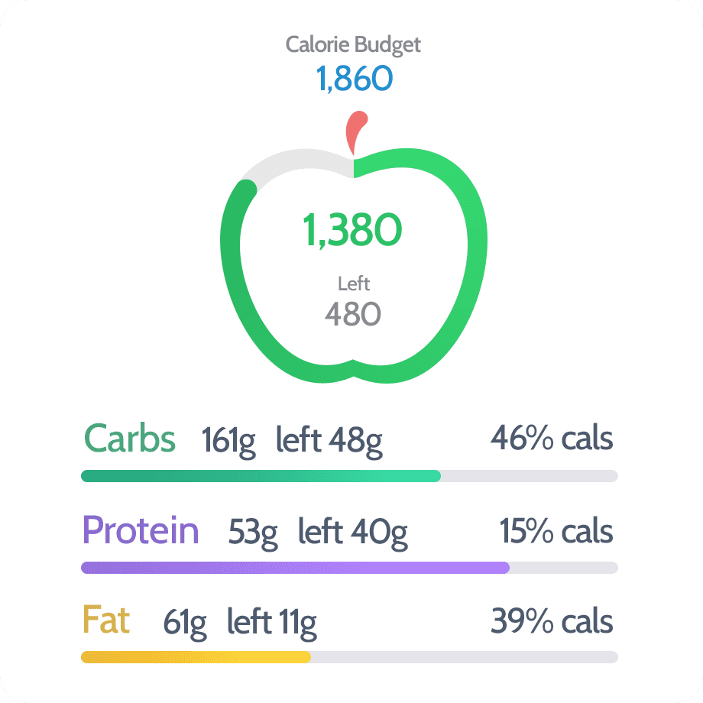

Key Features and Functionality
Key elements of the site:
Calory Tracker
Diet Tracker
Diet suggestions
Exercise suggestions
Intermittent fasting options
Health facts
Special functionality
Pop-up notifications – to keep pushing you towards your goal.
User-friendly interface.
It can be turned more real time in future by fusion with smart watches.
Upgradation to premium version.

Slide 5
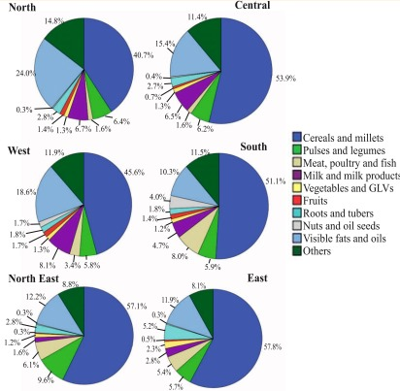

Social impact
• Our innovative solution is designed to make the entire process not only effortless but also enjoyable.
• Our primary goal is to make health accessible to a large number of people with less money.
• By making some changes in their health, we believe it can ultimately help in their productivity making them better members of the society.
• With our user-friendly calorie tracker, we've made it a breeze to keep tabs on your daily calorie consumption, all while having fun and feeling motivated on your health and fitness journey.
.

Slide 6


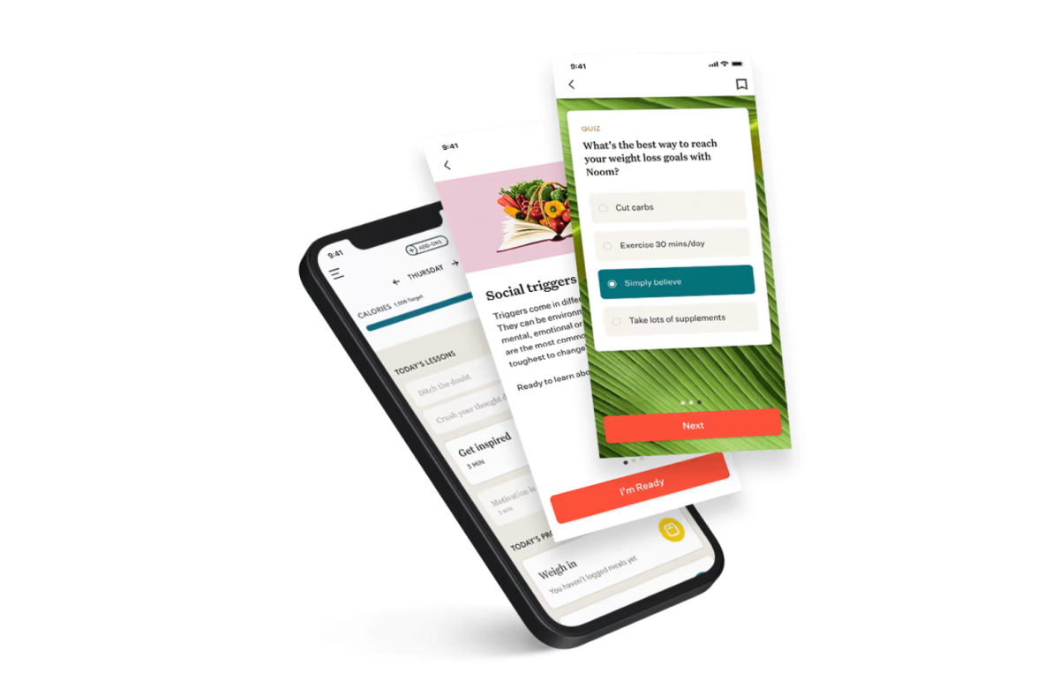
Revenue Model
Our revenue model will be based on the PREMIUM SUBSCRIPTION PLAN which will be based on different weekly, monthly and yearly plans tailored to the person's daily preferences.
We also recommend dietitians and pediatricians who practice near the user's location for our premium subscribers. Apart from that we also arrange online consultations with well qualified dietitians, pediatricians and psychologists for further enhancement of their health journey.

Slide 7



Technologies Used
The varying technologies used by us include
HTML
CSS
JavaScript
Python
Figma
Canva

Slide 8

The Team
NEHA K JOSEPH
ANSHIKA SINGH
MEGHANA V PATIL
22BCE7993
22BCE8512
22BCE9123

Slide 9


Thank You
HACKTOBER FEST

